Slide 1
Modeling exoplanet lithosphere properties using exoplex
Jenna Robinson
NASA Space Grant Symposium
April 13, 2019

Slide 2
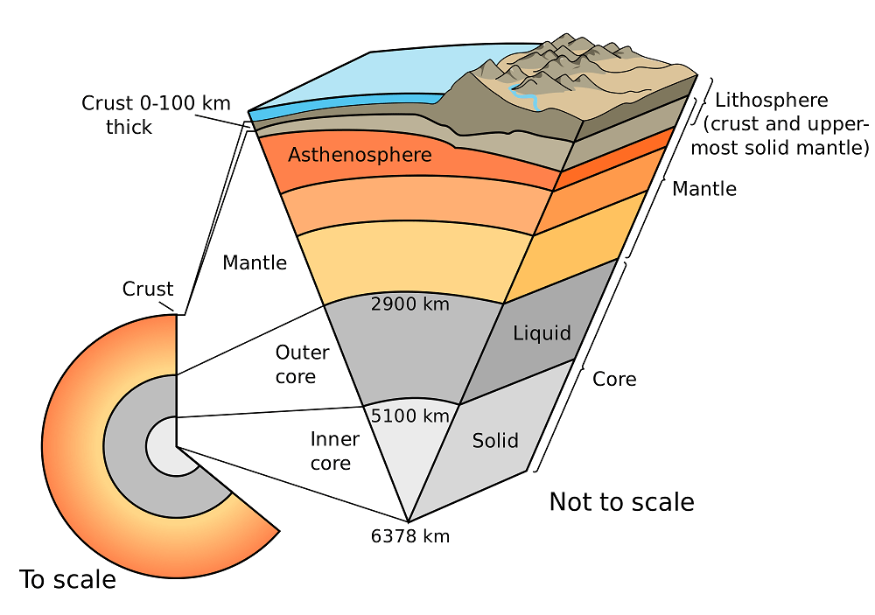
introduction

Slide 3
motivation
Question:
How thick are lithospheres?
What is the composition of lithospheres?
How does lithospheric composition impact thickness?
Objectives:
Edit ExoPlex library to include low temperature, low pressure datasets
Understand how pressure, temperature, and bulk planetary composition impact lithospheric thickness of exoplanets
Determine how thick the lithosphere can be for planets of differing compositions

Slide 4
methods
Determine the bulk chemical inputs of the model
Run the model for each bulk chemical composition case
Use the expansivity, density, specific heat, mineralogy, and thermal conductivity at characteristic pressure levels to calculate the combined thermal diffusivity of the lithosphere
Use the averaged thermal diffusivity value to calculate lithospheric thickness
H ~ 2[κL/V]^{1/2} = 2(κt)^{1/2}
H = thickness (m)
κ = thermal diffusivity
L = distance of the spreading center from the mid-oceanic ridge (m)
V = velocity of the lithospheric plate
t = lithosphere age

Slide 5
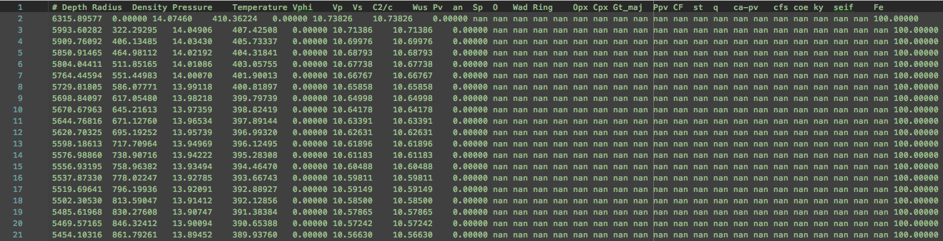
Results

Slide 6
significance
Conducting this experiment has showed the pitfalls of the ExoPlex model
Edit elemental inputs
Edit output file to calculate thickness
Modeling allows us to determine the atmospheric and geological properties of exoplanets
Planetary evolution
Variety of terrestrial exoplanets

Slide 7
Future work
Run the code for the remaining scenarios
Calculate the lithospheric thickness for each of these scenarios and compare

Slide 8
Conclusion
At this time, we are unable to deduce the effect of planetary composition on lithospheric thickness
We still have a lot of edits to make to the model before we can release it for public use

Slide 9
acknowledgements
Dr. Steve Desch, Space Grant mentor
Dr. Cayman Unterborn, postdoctoral research scientist
Shane Bechtel, Space Grant scholar
Mark Williamson, former Space Grant scholar and my biggest supporter

Slide 10
Questions?

Slide 11
references
“Lithosphere.” Wikipedia, Wikimedia Foundation, 1 Apr. 2019, en.wikipedia.org/wiki/Lithosphere.
Williams, Matt. “What Are the Earth’s Layers?” Universe Today, Universe Today, 21 Sept. 2016, www.universetoday.com/61200/earths-layers/.

